Slide 1

The Combustible Lemons
From Hillsboro High School

Slide 2
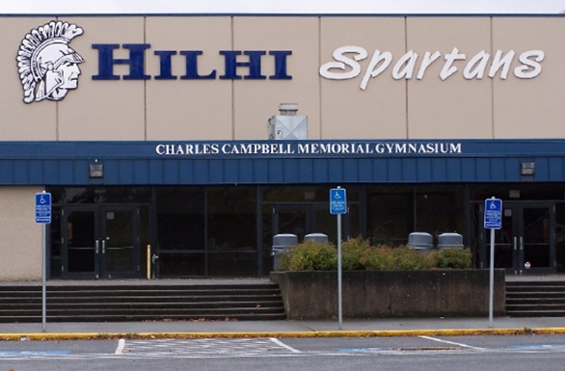

Who Are The Combustible Lemons?
Product Owner: Matthew
Scrum Master: Alejandro
Sound Design: J.T.
Blog Master: David
Coders: Tin and Jonathan
Art Direction: Ethan

Slide 3
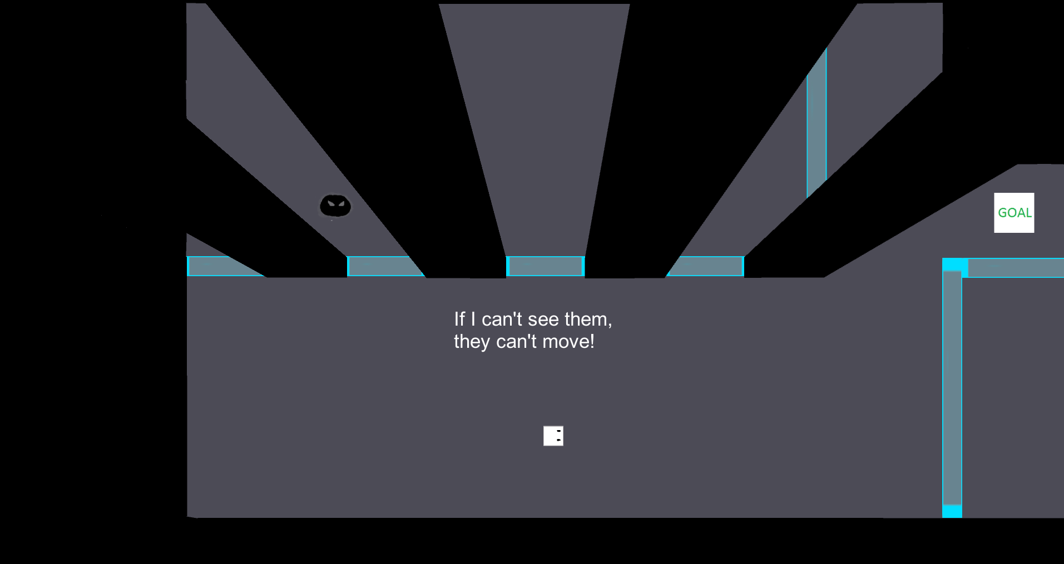
“I Can’t See You, You Can’t See Me”
Top Down 2d Puzzler with a twist of horror.
Max wakes up to find his Mom and Dad missing!
Our hero Max must traverse his house full of monster to rescue his parents.

Slide 4

Game Mechanics
Vision Mechanic: If Max can’t see something, it cannot move.
Rotating Doors: Doors that rotate.
Monsters: Move forward towards Max when he can see them.

Slide 5

Arts and Assets
Includes :
Sprites
Music
Sound Effects
Scenery

Slide 6

Sprites
Follows Max
Tries to stop him from saving his parents
Is a spooky spirit that doesn't want the player to win.

Slide 7


Music and Sound Effects
All music is created by the teams Sound Design Manager
Menu music:
In-game music:

Slide 8
Scenery
Set in Max’s house.
Big rooms to navigate.
Monsters hide behind walls and windows.
Max is only safe when he closes his eyes.

Slide 9

Tools
Unity 5.0 - Development environment -http://unity3d.com/
GitHub – Organization tool - https://github.com/
Waffle.io – GitHub enhancer to help stay organized - https://waffle.io/
Microsoft Visual Studio – C# coding - https://www.visualstudio.com/
Tumblr – Blogging - https://www.tumblr.com/blog/ogpccombustiblelemons
Magix Music Maker 2015 – Music creation - http://www.magix.com/us/music-maker/
Photoshop CS5 – Self made sprites and backgrounds - http://www.photoshop.com/

Slide 10
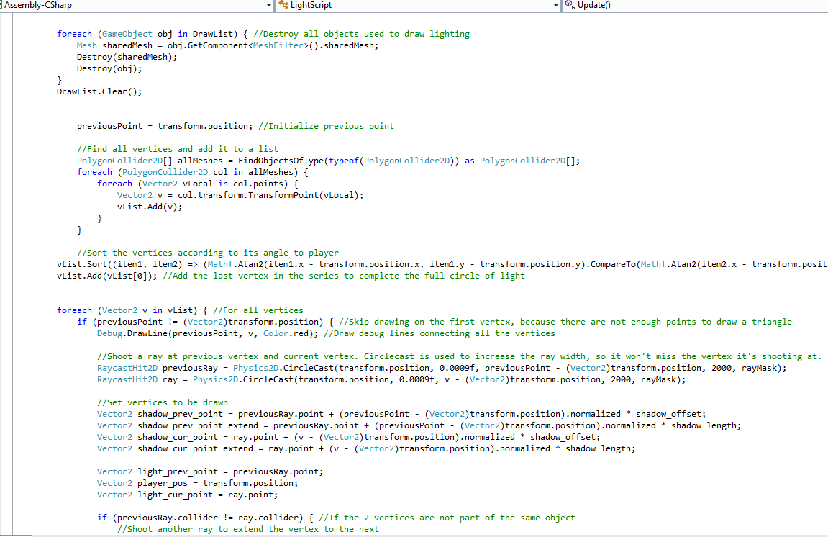
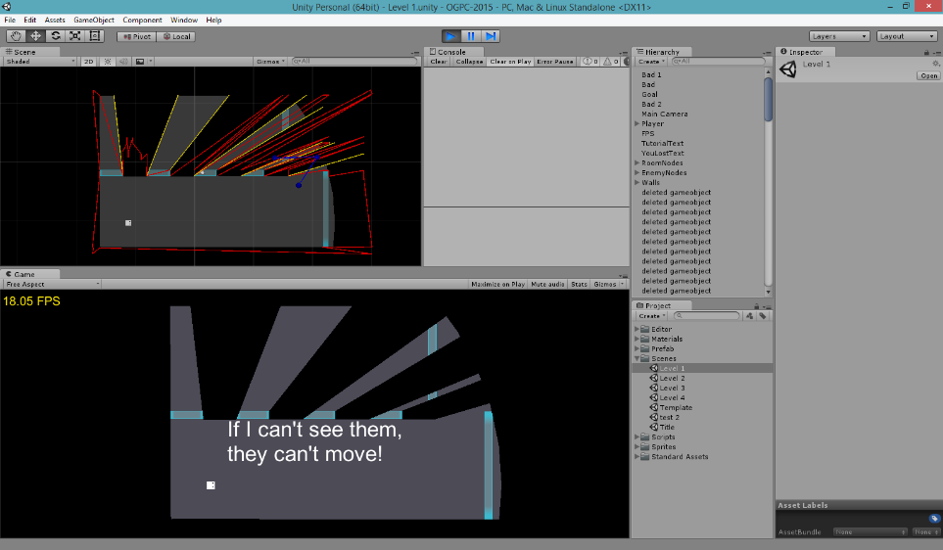
Coding the Game
Vertex based vision system.
Enemy AI using the A* path finding algorithm.
Using Unity and C# languages.
Tested using usability testing.
Tracked bugs using GitHub.

Slide 11
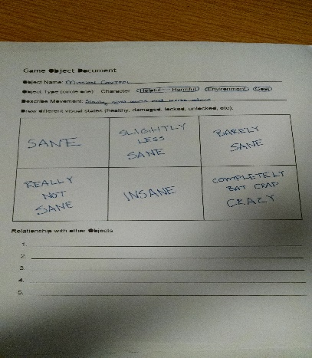
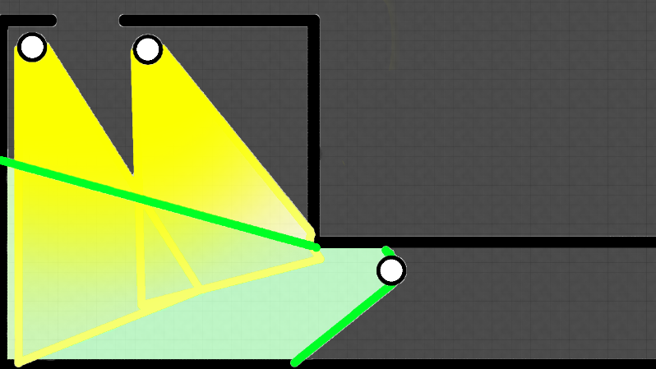
History
Original ideas:
Rescue Mission Control
Stealth
Psychological Experience
Insanity
Randomly Generated Levels

Slide 12
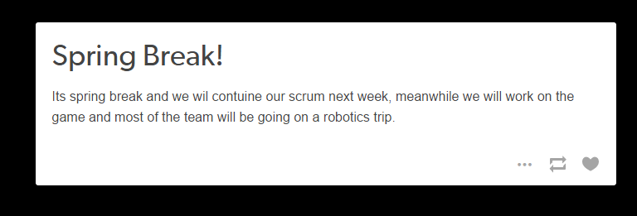
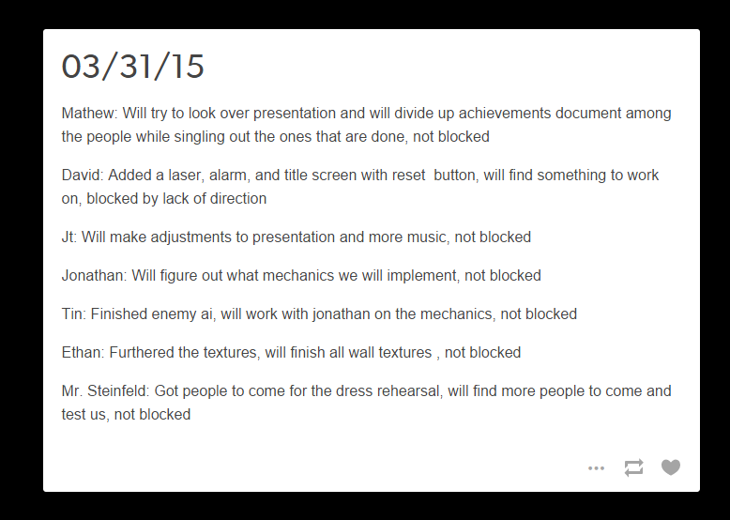
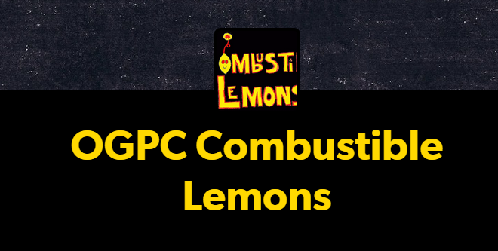
Methodology
Agile Development/Scrum
Blogging
Version Control

Slide 13



Questions?

